Slide 1
Agents of Erosion

Slide 2
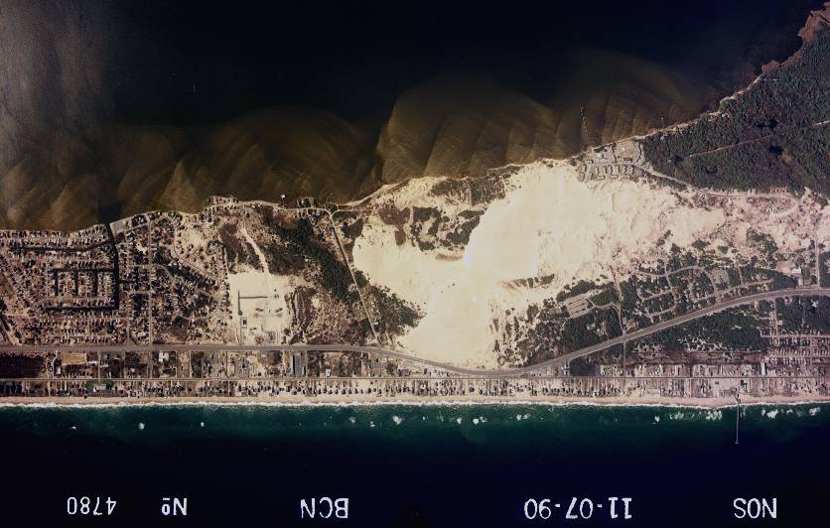
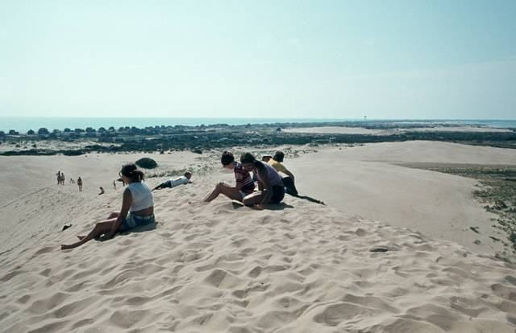
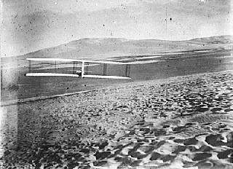
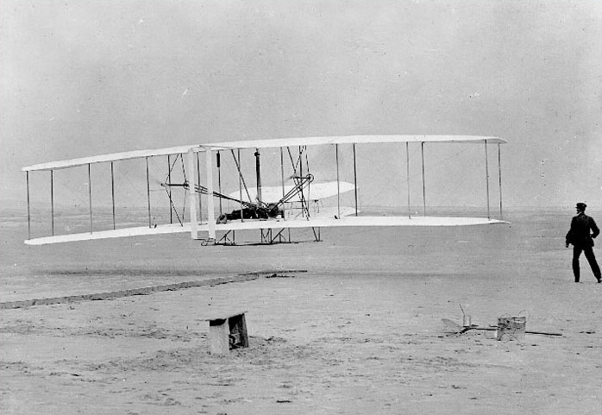
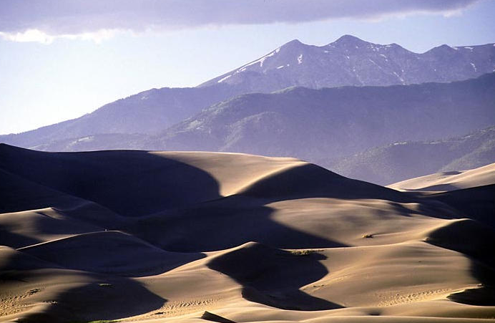
WIND
Dunes
Jockey’s Ridge, NC
N
Kill Devil Hills, NC
Orville Wright
glider test
Oct. 24, 1902
Orville Wright
First Flight
Dec. 12, 1903
120 feet; 12 sec.
Great Sand Dunes NM, CO
D. Hardin

Slide 3
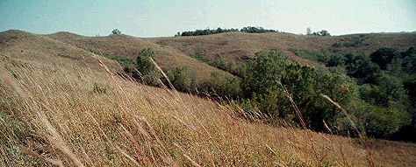
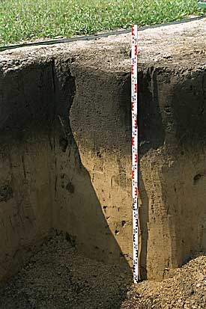
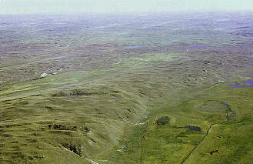
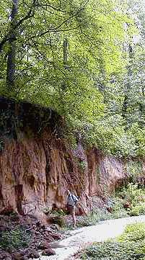
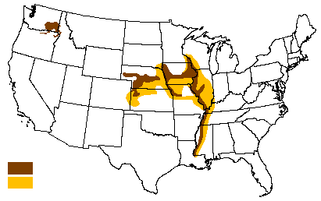
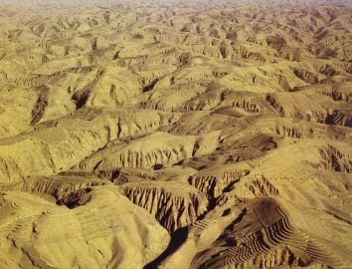
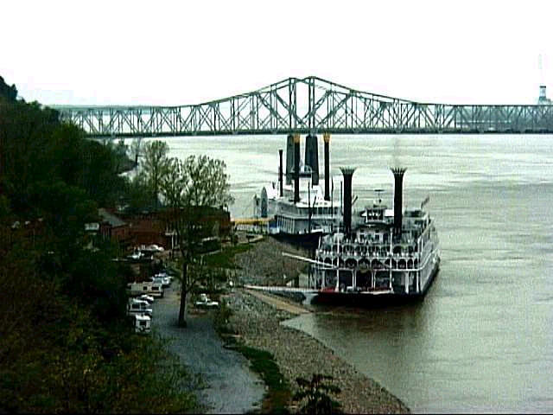
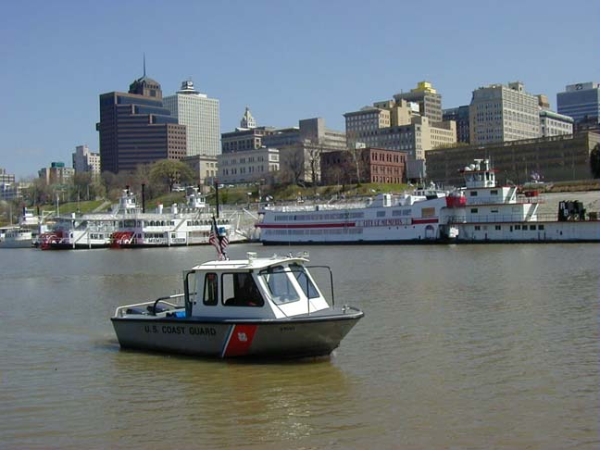
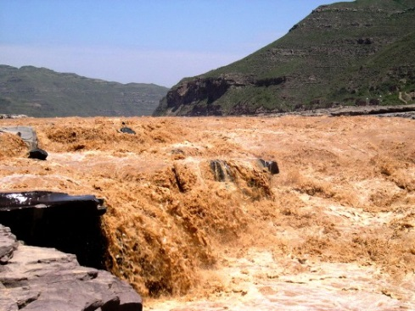
WIND
Loess
Nebraska Sand Hills
Iowa Loess Hills
THICKNESS OF LOESS DEPOSITS
Palouse
biome
>25 feet
5-25 feet
Natchez
Memphis
D. Hardin

Slide 4
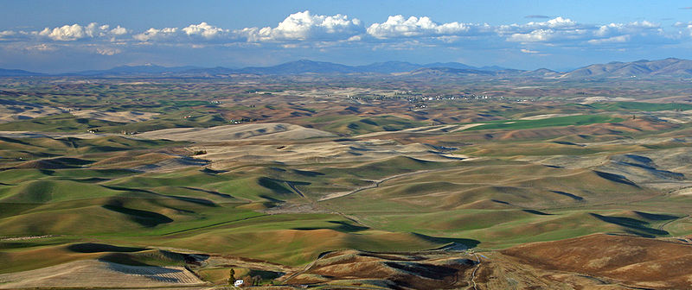
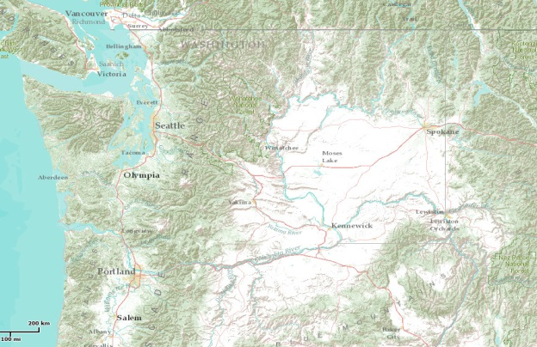
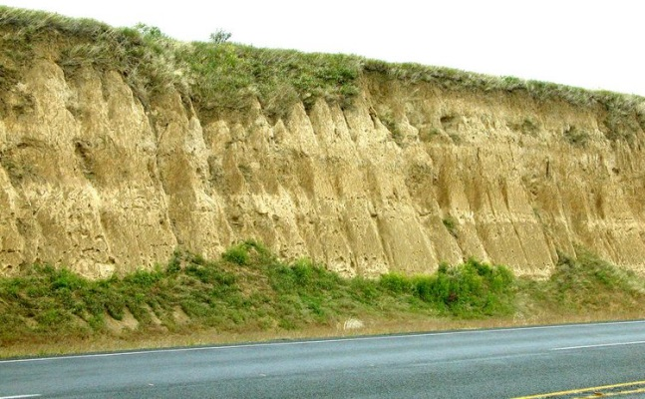
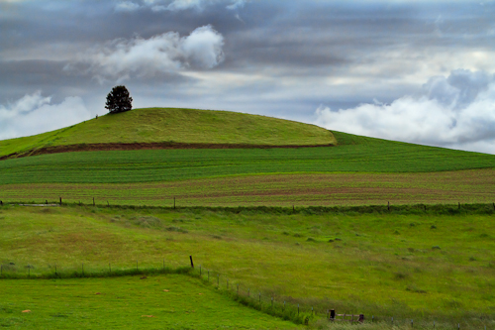
WIND
Loess
Palouse
IMPORTANT TO
REMEMBER!
winds
Palouse biome
D. Hardin

Slide 5
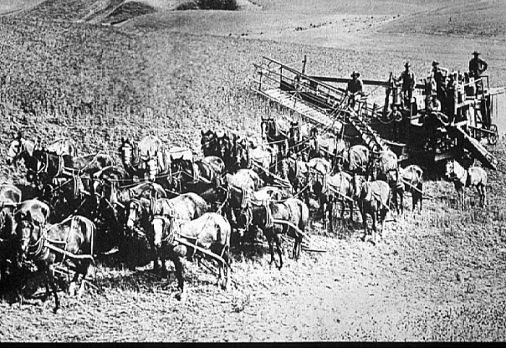
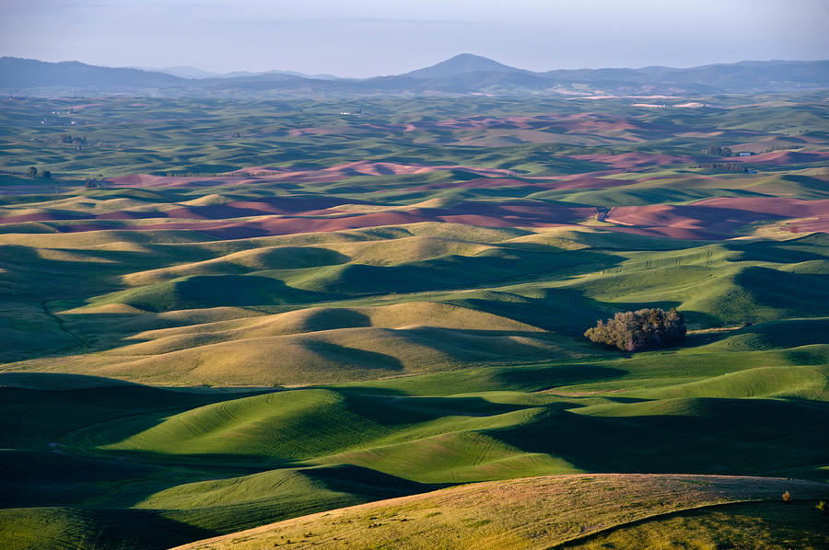
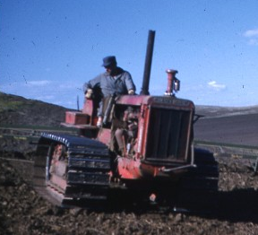
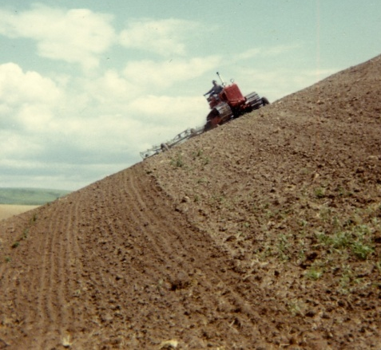
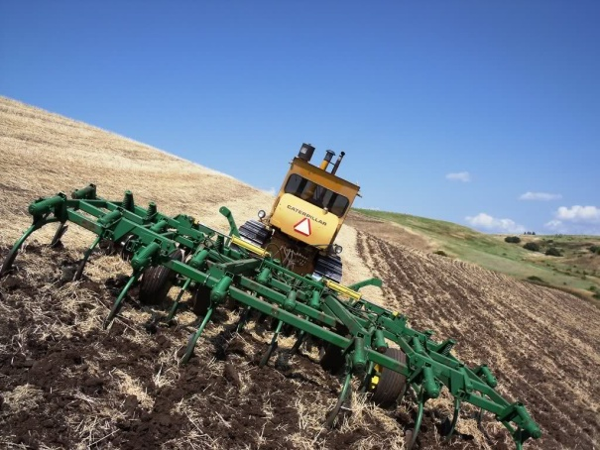
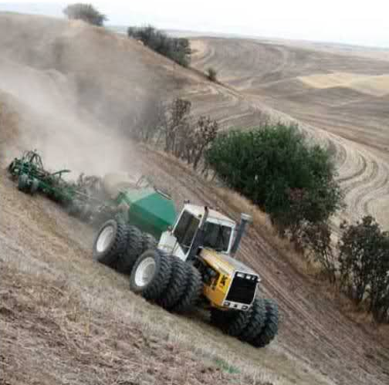
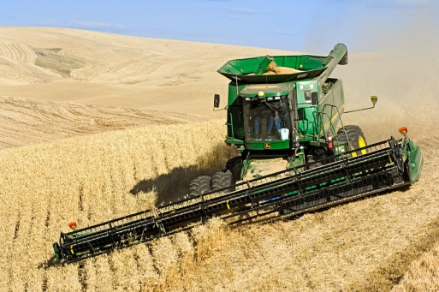
WIND
Loess
Palouse
IMPORTANT TO
REMEMBER!
D. Hardin

Slide 6
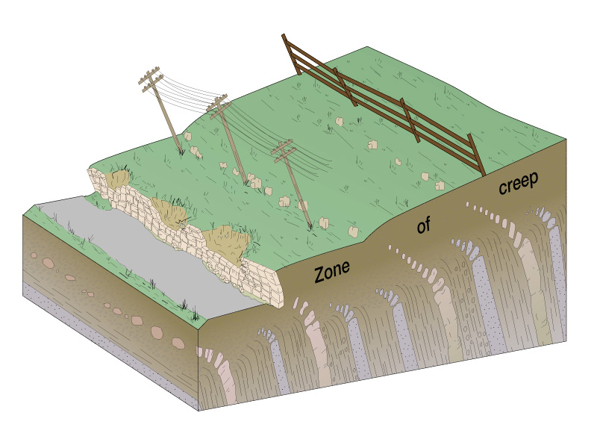
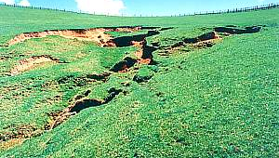
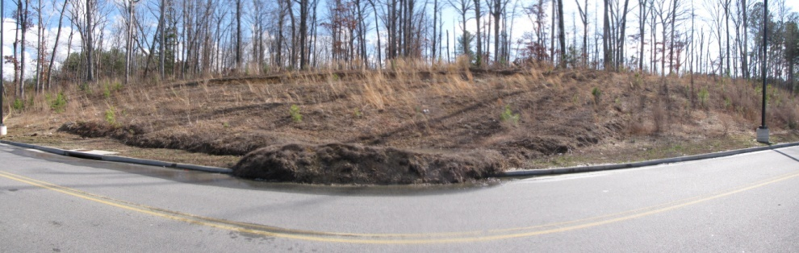
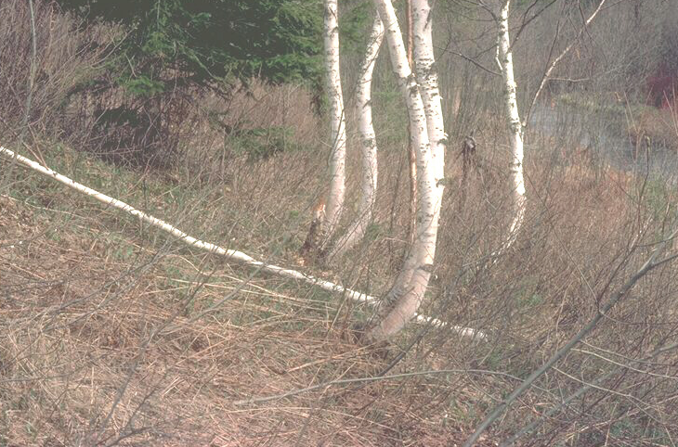
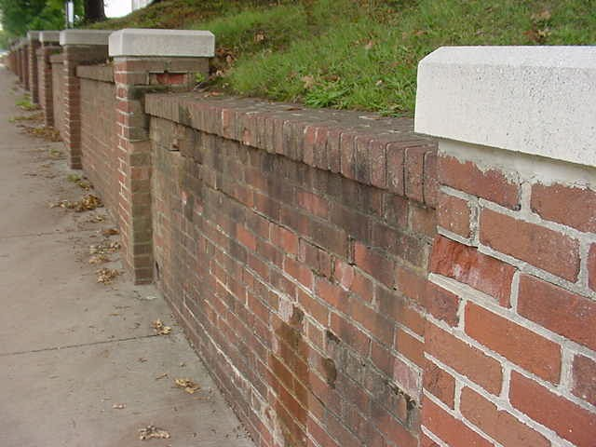
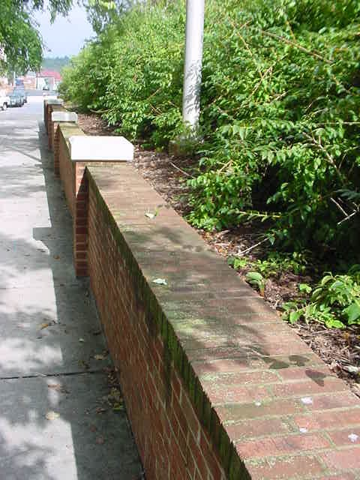
GRAVITY
Soil creep
D. Hardin

Slide 7
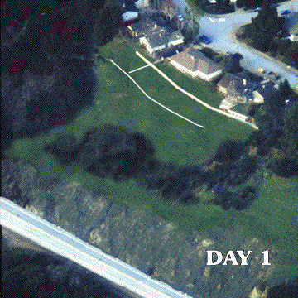
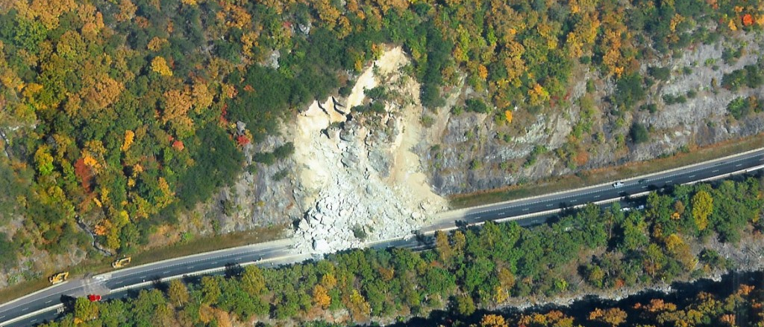
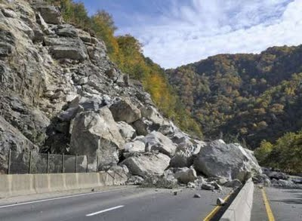
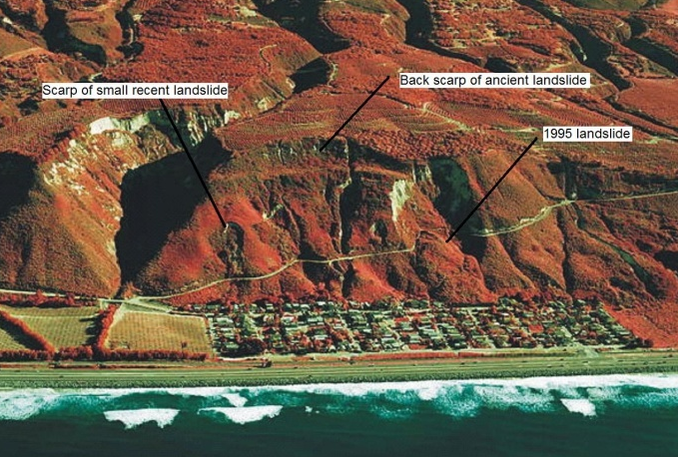
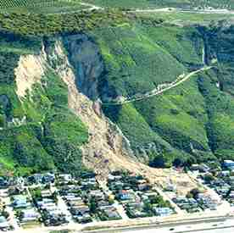
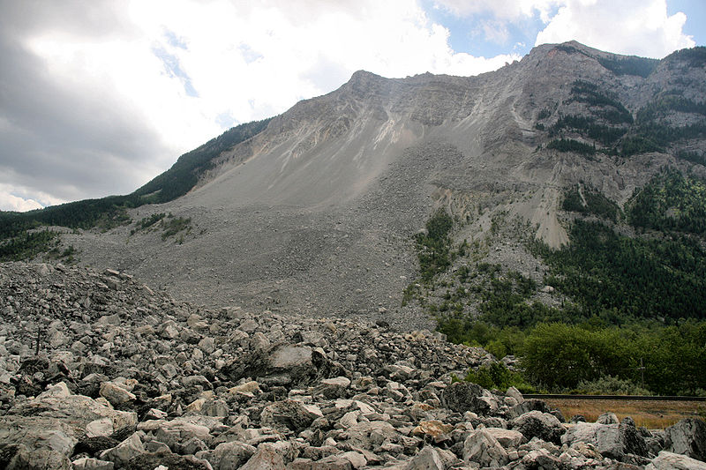
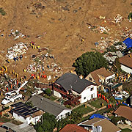
GRAVITY
Landslide
I-40, TN-NC border, 2009
La Conchita, CA
2005
Frank Slide, BC, 1903
D. Hardin

Slide 8
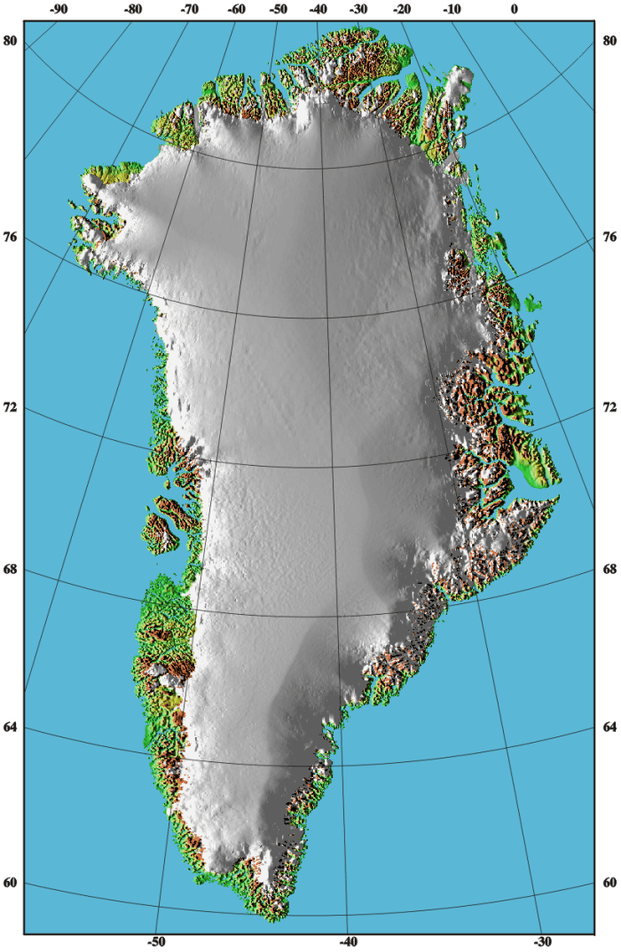
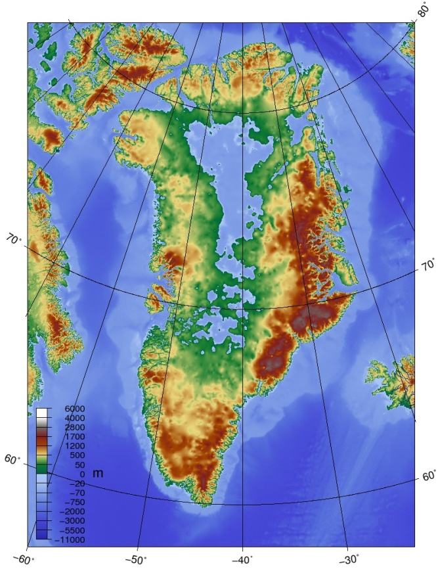
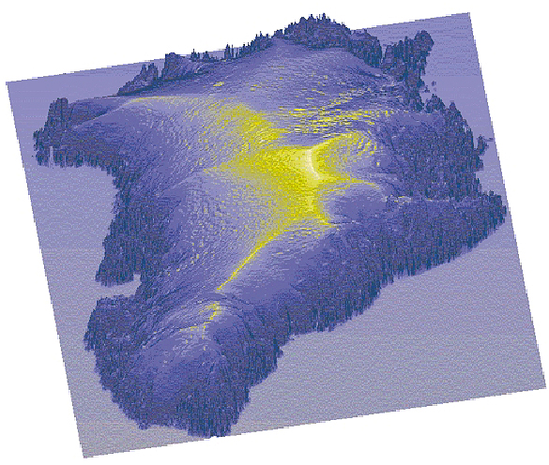
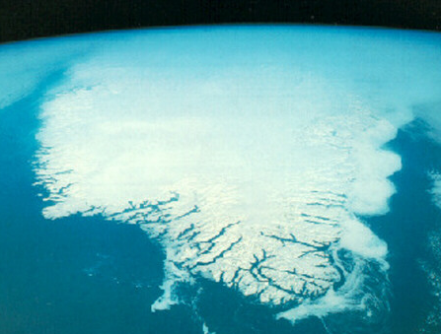
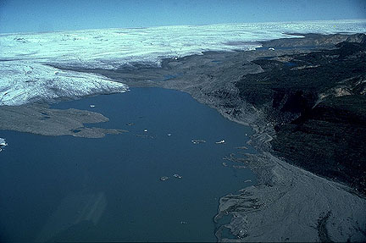
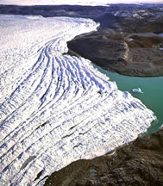
ICE
Continental glaciers
Greenland
Summit
3,207 meters
10,521 feet
D. Hardin

Slide 9
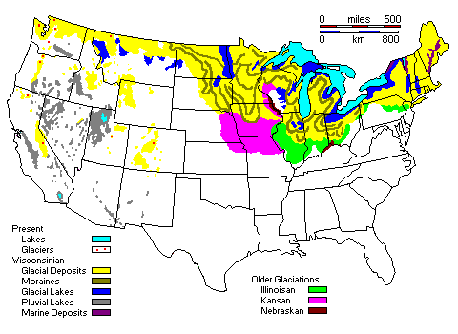
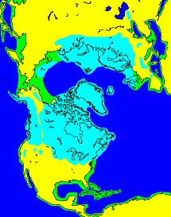
ICE
Continental glaciers
Pleistocene glaciations
D. Hardin

Slide 10

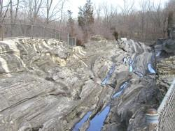
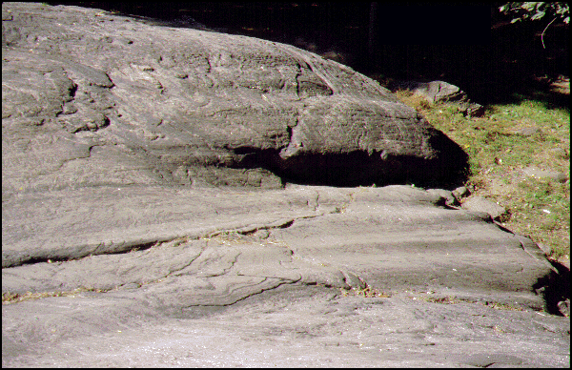
ICE
Continental glaciers
Excavation
Kelly’s Island, OH
Central Park, NY
D. Hardin

Slide 11
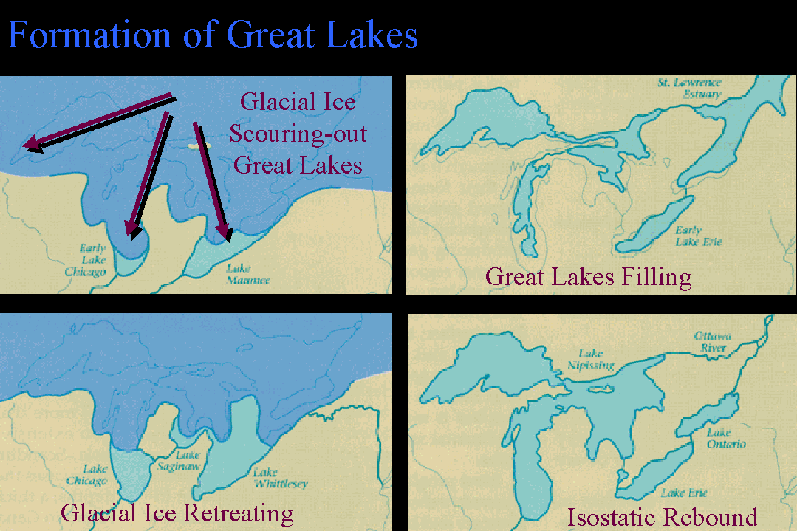
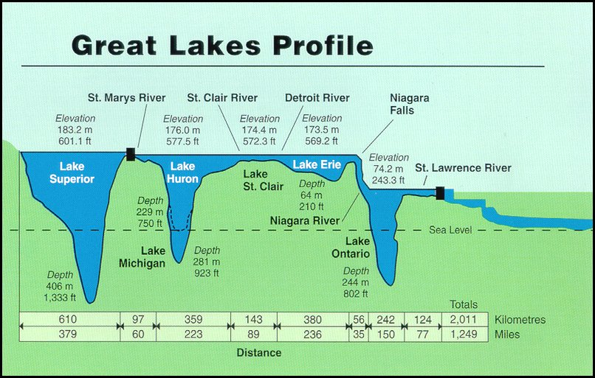
ICE
Continental glaciers
Excavation
D. Hardin

Slide 12





ICE
Continental glaciers
Deposition
Illinois
Iowa - bedrock
Terminal and
recessional
moraines
Iowa - surface
Glacial
limit
D. Hardin

Slide 13




ICE
Continental glaciers
Deposition
Till, moraines, and erratics, Illinois
D. Hardin

Slide 14


ICE
Continental glaciers
Deposition
Mississippi Headwaters
Lake Itasca MN
Deranged drainage in Upper Midwest
Minneapolis
D. Hardin

Slide 15




ICE
Continental glaciers
Deposition
Deranged drainage in Upper Midwest
National Freshwater Fishing Hall of Fame
Hayward WI
D. Hardin

Slide 16




ICE
Continental glaciers
Deposition
Diversion of the Missouri River
MT
MN
Red R.
Coteau du Missouri
Missouri R.
ND
SD
D. Hardin

Slide 17

ICE
Continental glaciers
Deposition
New England
Cape
Cod
Martha’s
Vinyard
Nantucket
Island
Long Island
Maximum extent
of glaciation
D. Hardin

Slide 18
ICE
Continental glaciers
Pleistocene glaciations
D. Hardin

Slide 19



ICE
Alpine glaciers
D. Hardin

Slide 20




ICE
Alpine glaciers
U-shaped valleys
V-shaped valley
U-shaped valley
Grand Canyon of the Yellowstone, WY
Rock Creek Valley, MT
Yosemite Valley, CA
Lauterbrunnen Valley, Switz.
D. Hardin

Slide 21





ICE
Alpine glaciers
Norwegian Fjords
Geiranger Fjord
Sogna Fjord Uplands
Lyse Fjord
3,338’
Geiranger Fjord
26+ hairpins!
D. Hardin

Slide 22






ICE
Alpine glaciers
Glacier Bay
Alaskan fjords
Inside Passage
D. Hardin

Slide 23


ICE
Alpine glaciers
Chilean fjords
Magellan
Strait
of
D. Hardin

Slide 24



ICE
Alpine glaciers
Sharpened features
Matterhorn
Grand Tetons, WY
D. Hardin

Slide 25
WIND
Dunes
Jockey’s Ridge, NC
N
Kill Devil Hills, NC
Orville Wright
glider test
Oct. 24, 1902
Orville Wright
First Flight
Dec. 12, 1903
120 feet; 12 sec.
Great Sand Dunes NM, CO
D. Hardin

Slide 26
WIND
Loess
Nebraska Sand Hills
Iowa Loess Hills
THICKNESS OF LOESS DEPOSITS
Palouse
biome
>25 feet
5-25 feet
Natchez
Memphis
D. Hardin

Slide 27
WIND
Loess
Palouse
IMPORTANT TO
REMEMBER!
winds
Palouse biome
D. Hardin

Slide 28
WIND
Loess
Palouse
IMPORTANT TO
REMEMBER!
D. Hardin

Slide 29
GROUND WATER
Karst Topography
Luray Caverns
D. Hardin

Slide 30
GROUND WATER
Karst Topography
Luray Caverns
stalactite
column
stalagmite
D. Hardin

Slide 31




GROUND WATER
Karst Topography
Luray Caverns
D. Hardin

Slide 32





GROUND WATER
Karst Topography
Caverns
Endless Caverns, VA
Shenandoah Caverns, VA
Guilin Caverns, China
Mammoth Cave, KY
Carlsbad Caverns, NM
D. Hardin

Slide 33
GROUND WATER
Karst Topography
Sinkholes
D. Hardin

Slide 34




GROUND WATER
Karst Topography
Sinkholes
Shenandoah Valley, VA
St. Petersburg, FL 2002
Frederick, MD 1995
Barren River, KY
D. Hardin

Slide 35




GROUND WATER
Karst Topography
Winter Park, FL 1981
Florida sinkholes
D. Hardin

Slide 36


GROUND WATER
Karst Topography
Natural Tunnel
D. Hardin

Slide 37

GROUND WATER
Karst Topography
Natural Bridge
D. Hardin

Slide 38





SURFACE WATER
Degradation
Raised base level
D. Hardin

Slide 39


SURFACE WATER
Degradation
Lowered base level
D. Hardin

Slide 40




SURFACE WATER
Degradation
Lowered base level
D. Hardin

Slide 41
SURFACE WATER
Transportation
Suspention
Stream flow
Suspention
D. Hardin

Slide 42




SURFACE WATER
Transportation
Suspension
Passau, Germany
Huang He R., China
Inn
Danube
Red R., TX-OK
Ilz
White R., SD
D. Hardin

Slide 43
SURFACE WATER
Transportation
Saltation
Stream flow
Saltation
D. Hardin

Slide 44


SURFACE WATER
Transportation
Saltation
Stream flow
D. Hardin

Slide 45
SURFACE WATER
Transportation
Suspention
Stream flow
Traction
D. Hardin

Slide 46



SURFACE WATER
Transportation
Traction
Blue Ridge Mountain stream
stream near Old Rag
Rapidan River
D. Hardin

Slide 47



SURFACE WATER
Deposition
Floodplain
D. Hardin

Slide 48

SURFACE WATER
Deposition
Meander
Down valley
sweep
A’
Point bar
deposits
B
Ford
A
B’
Undercut
bank
A
A’
B
B’
Riffle
D. Hardin

Slide 49

SURFACE WATER
Deposition
Meander
MO
TN
AR
Down Valley Sweep of the
Meanders of the Mississippi
Near Moss Island, TN
Yellow = 1765 survey
Blue = 1820-30 survey
Green = 1881-93 survey
Red = 1930-32 survey
Solid blue = 1999 survey
Purple = meander scars
N
Moss
Island
1821
cut-off
loess bluff
D. Hardin

Slide 50




SURFACE WATER
Deposition
Natural levees
Destrehan, LA
St. Louis, MO 1858
D. Hardin

Slide 51





SURFACE WATER
Lower Mississippi River
D. Hardin

Slide 52
SURFACE WATER
SURFACE WATER
Deposition
Mississippi River deltas
D. Hardin

Slide 53






SURFACE WATER
Deposition
River deltas
Fan-shaped
Truncated
Bird’s Foot
Nile
Amazon
Mississippi
Niger
Congo
Volga
D. Hardin

Slide 54

SURFACE WATER
New Orleans
D. Hardin

Slide 55


SURFACE WATER
New Orleans
D. Hardin

Slide 56




SURFACE WATER
New Orleans
D. Hardin

Slide 57


SURFACE WATER
New Orleans
Hurricane Katrina
August 29, 2005
D. Hardin

Slide 58




SURFACE WATER
New Orleans
D. Hardin

Slide 59

SURFACE WATER
New Orleans
D. Hardin

Slide 60


SURFACE WATER
New Orleans
D. Hardin

