Slide 1
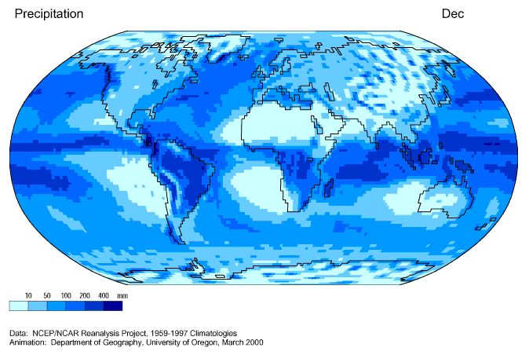
CLIMATIC
INFLUENCES

Slide 2
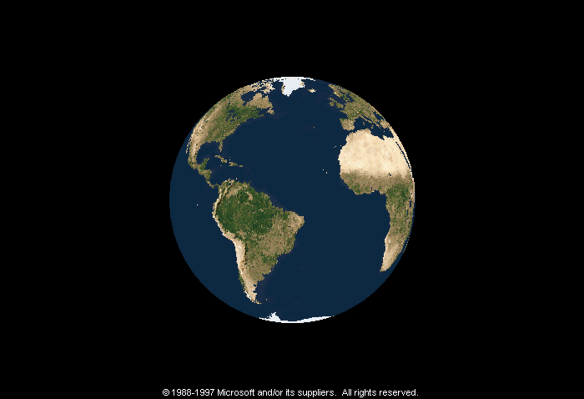
CLIMATIC INFLUENCES
Subtropical High
SUBTROPICAL
HIGH
H
≈ 30° N
23½° N
Hadley
Cell
Tropic of Cancer
EQUATORIAL LOW
InterTropical Convergence Zone
L
0°
Tropic of Capricorn
Hadley
Cell
23½° S
SUBTROPICAL
HIGH
H
≈ 30° S
D. Hardin

Slide 3
CLIMATIC INFLUENCES
Subtropical High
DRY SUMMERS
DRY ALL YEAR
Sonoran
DRY WINTERS
Atacama
Australian
Kalahari
D. Hardin

Slide 4
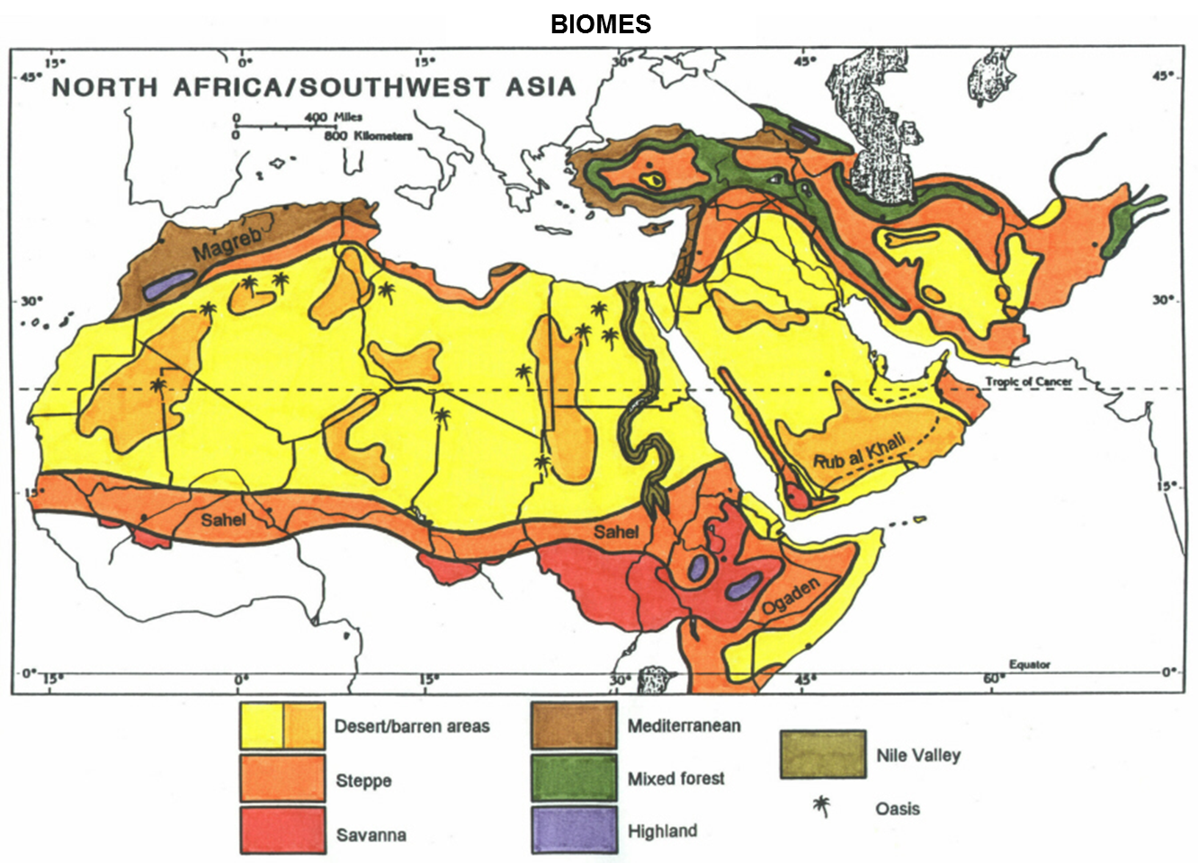

Biomes

Slide 5
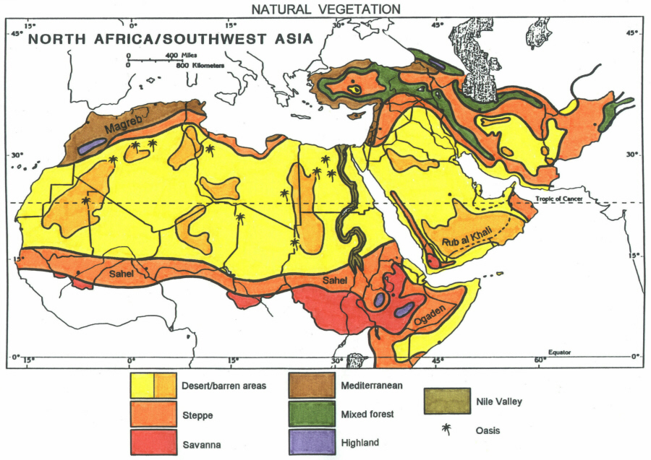
BIOMES
Sahara
Arabian

Slide 6
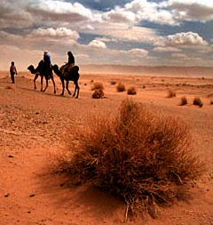
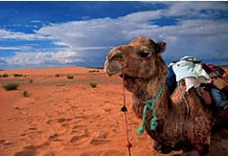
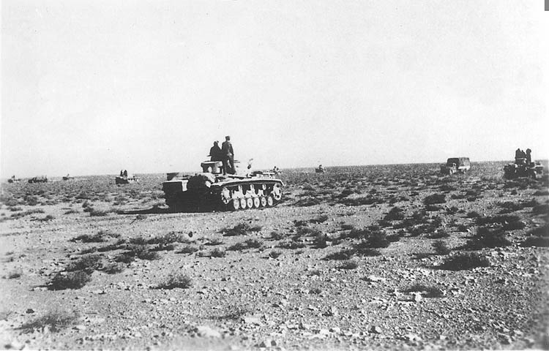
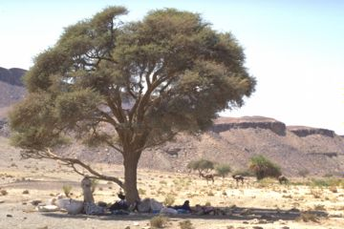
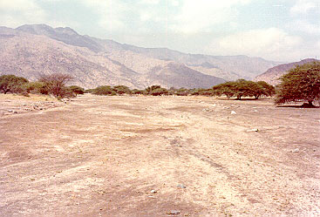
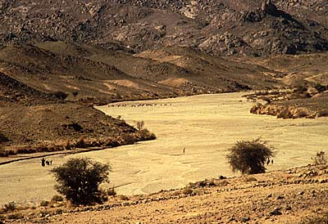
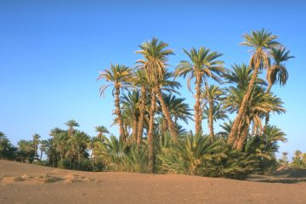
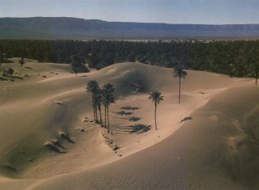
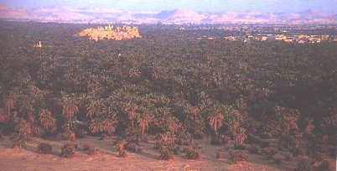
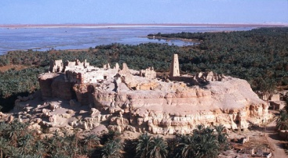
BIOMES
Subtropical High Desert
Sahara Desert
Morocco
Morocco
Libya, 1942
Algeria
Sudan
Egypt
Tunisia
Libya
Siwa, Egypt
Oracle of Amun
D. Hardin

Slide 7
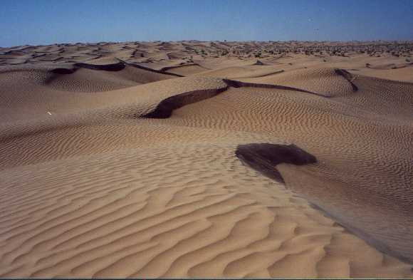
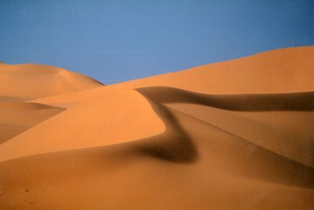
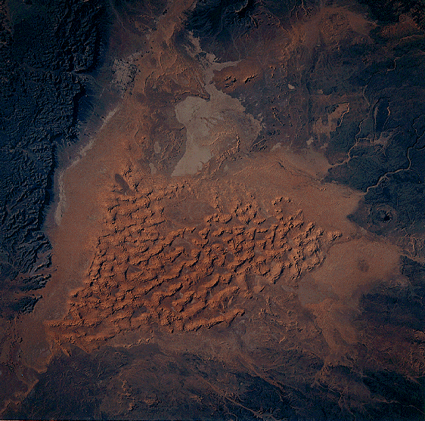
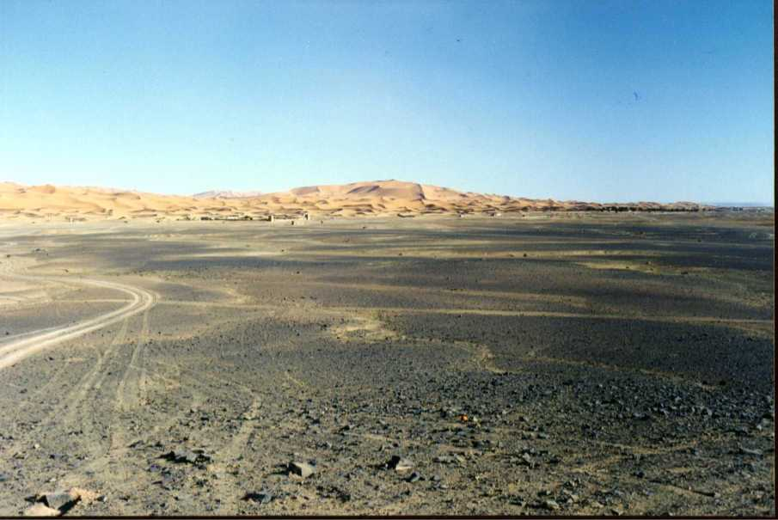
BIOMES
Subtropical High Desert
Sahara Desert
Erg
Libya
Tunisia
Morocco
D. Hardin

Slide 8
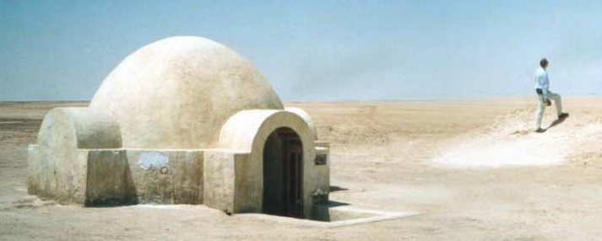
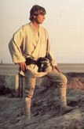
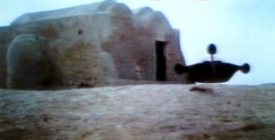
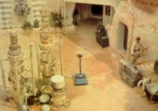
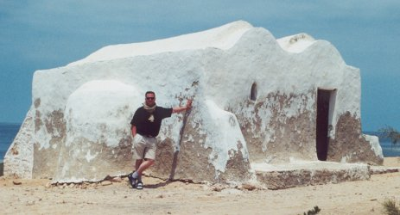
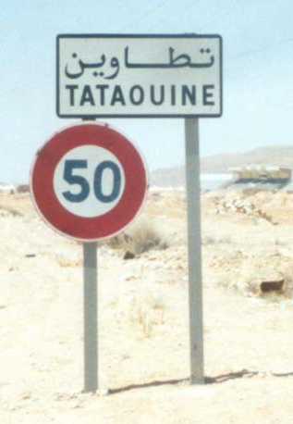
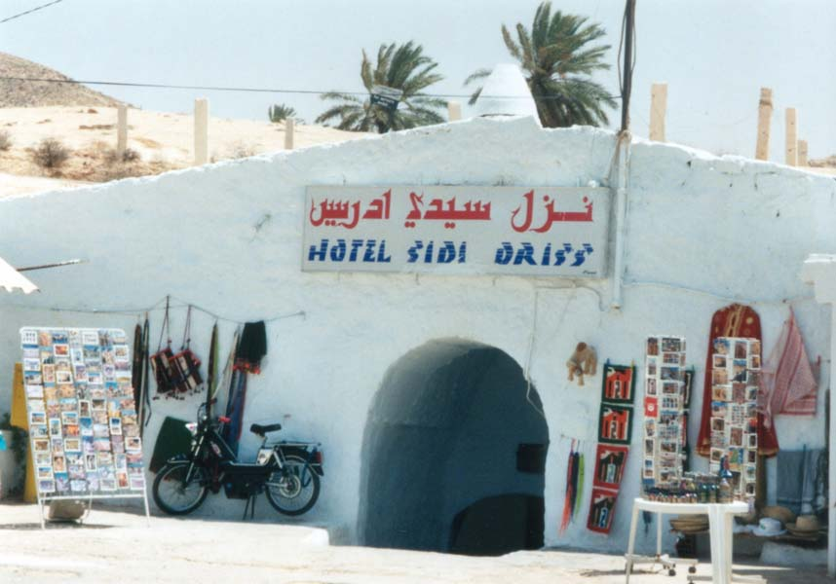
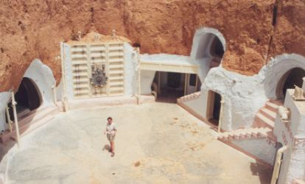

BIOMES
Subtropical High Desert
Tunisia
Lars Homestead
Ben Kenobi’s home
Luke Skywalker
D. Hardin

Slide 9
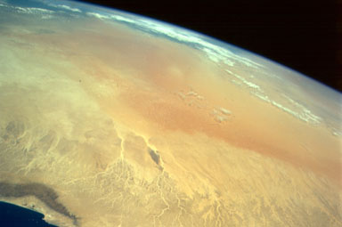
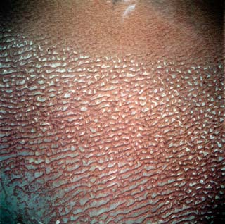
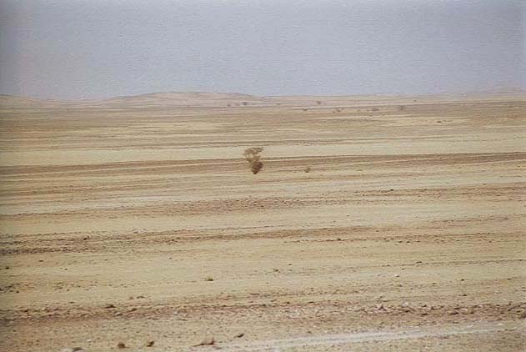
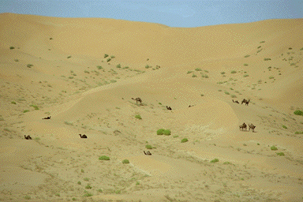
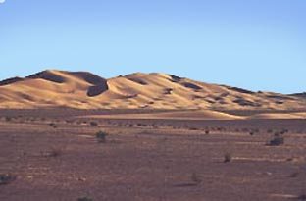
BIOMES
Subtropical High Desert
Arabian Desert
Rub al Khali
D. Hardin

Slide 10
BIOMES
Iranian

Slide 11
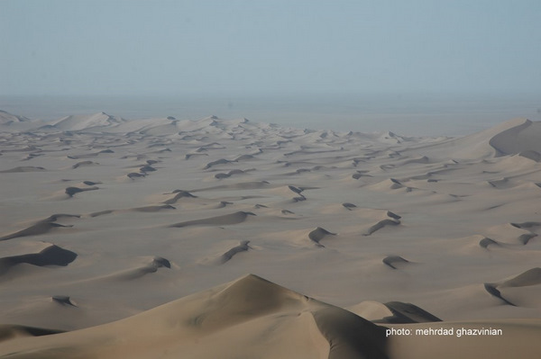
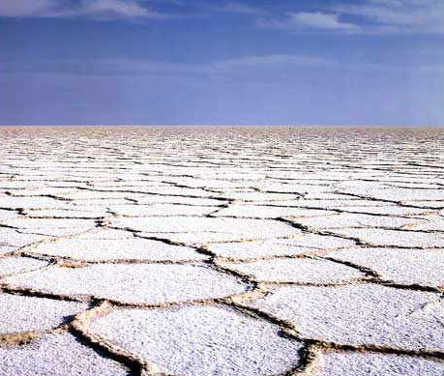
BIOMES
Rainshadow Desert
Iranian Desert
Great Salt Desert
D. Hardin

Slide 12
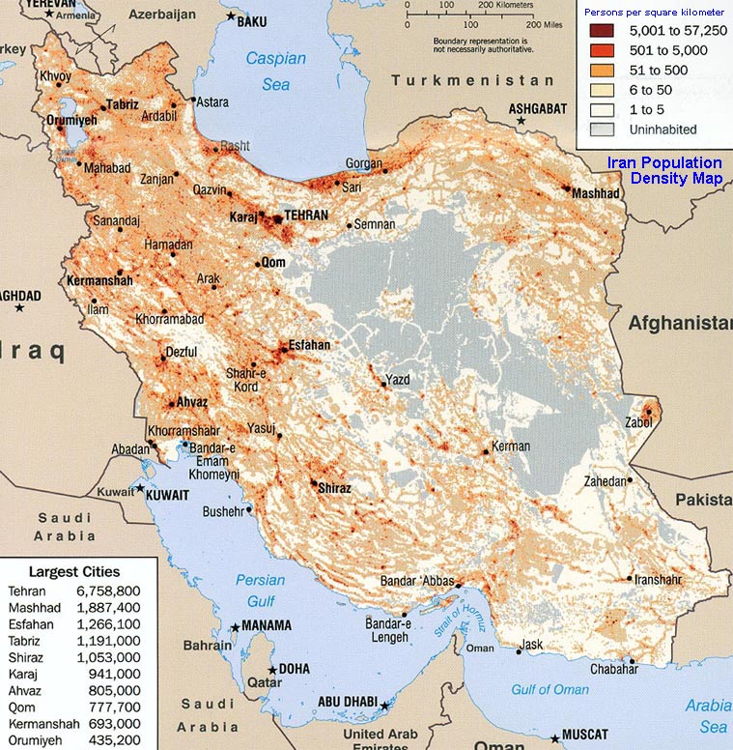
BIOMES
Rainshadow Desert
Iranian Desert
Great Salt Desert
D. Hardin

Slide 13
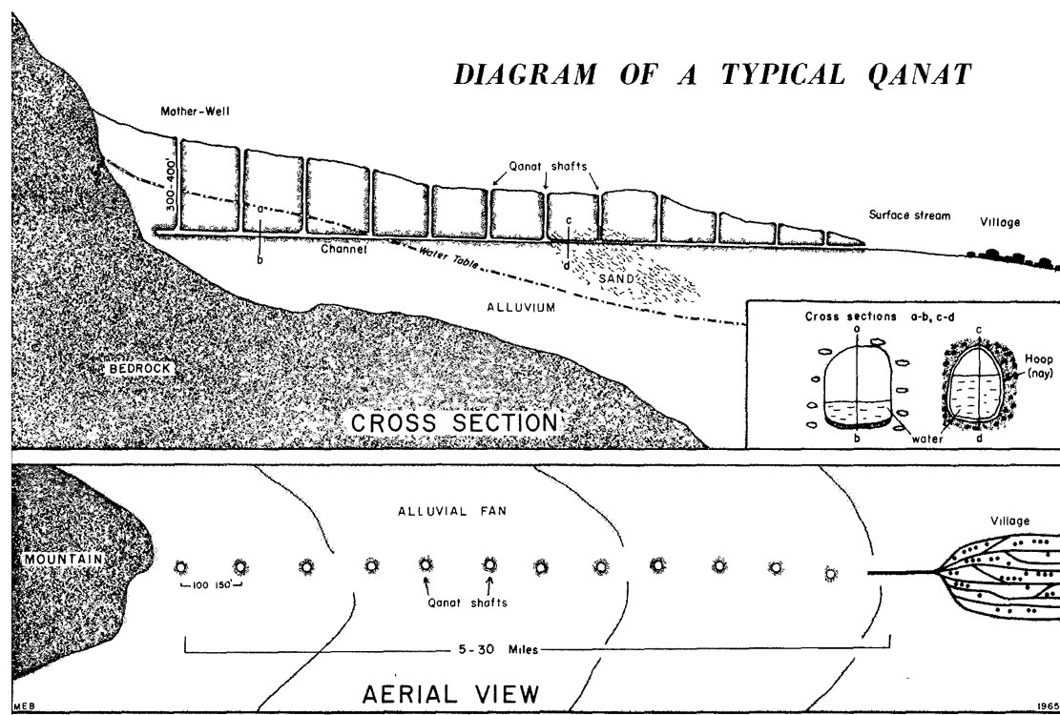
BIOMES
Rainshadow Desert
Iranian Desert
qanat
D. Hardin

Slide 14
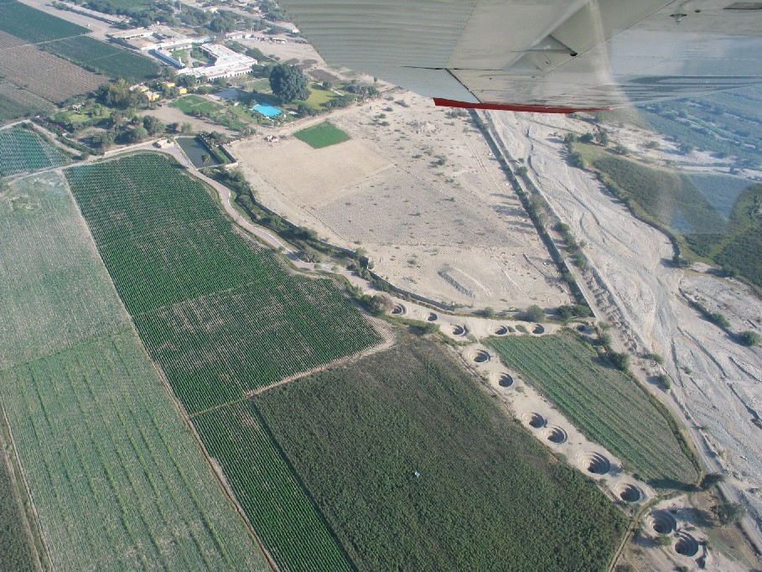
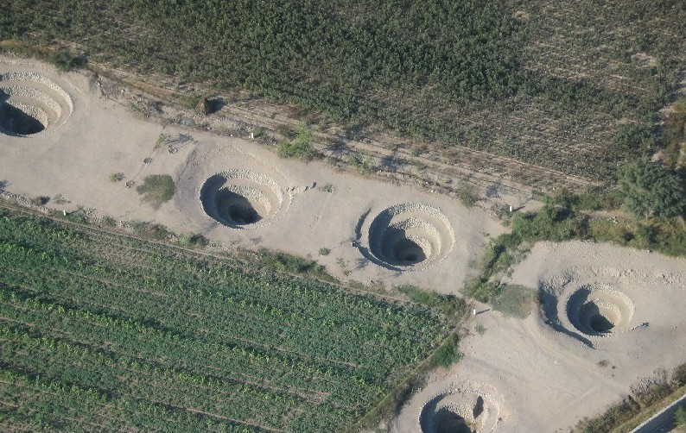
BIOMES
Rainshadow Desert
Iranian Desert
qanat
D. Hardin

Slide 15
BIOMES
Levant

Slide 16
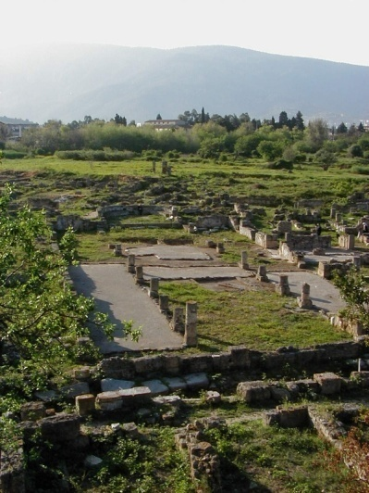
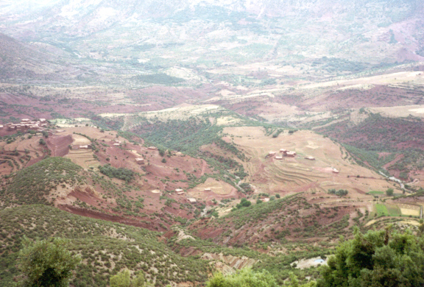
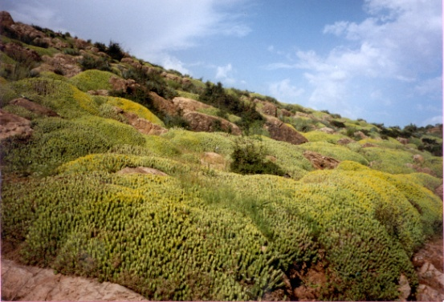
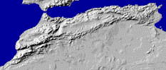
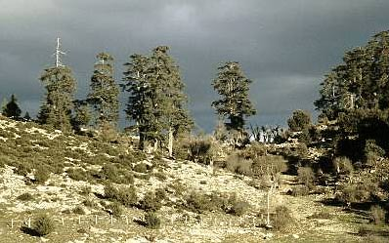
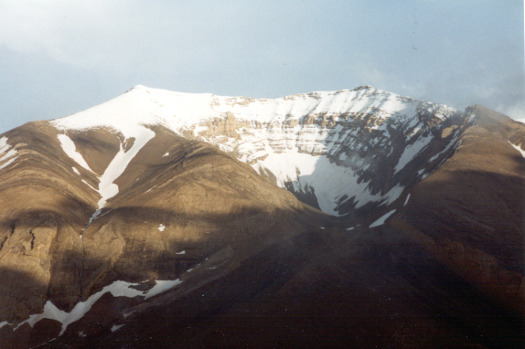
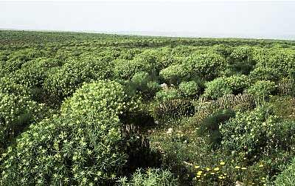
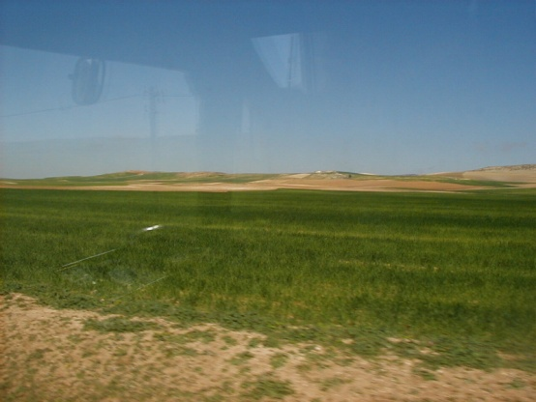
BIOMES
Mediterranean
Maghreb
D. Hardin

Slide 17
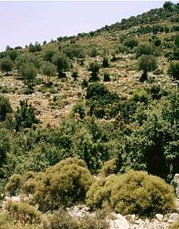
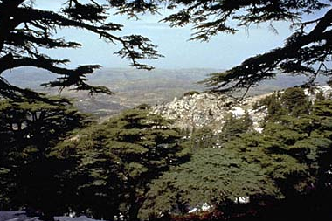
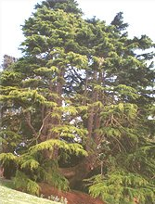
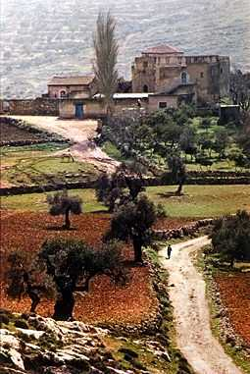

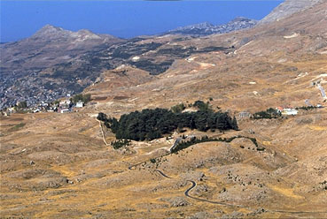

BIOMES
Mediterranean
Levant
Cedars of Lebanon
Turkey
West Bank
Cyprus
D. Hardin

Slide 18
BIOMES
Elburz
Zagros

Slide 19







BIOMES
Tehran, Iran
Mixed forests
Elburz Mts.
Turkey - north
Turkey - south
Zagros Mts.
D. Hardin

Slide 20
BIOMES

Slide 21





BIOMES
Steppe
Syria
Turkey
central
east
Jordan
D. Hardin

Slide 22




BIOMES
Steppe
D. Hardin

Slide 23
FERTILE CRESCENT
BIOMES

Slide 24

FERTILE CRESCENT
Çatalhöyük
Jericho
D. Hardin

Slide 25







FERTILE CRESCENT
Plant & Animal Domestication
wild grasses
auroch
wheat
D. Hardin

Slide 26


FERTILE CRESCENT
Neolithic Period
Jericho
10,000-9,000 BCE - present
D. Hardin

Slide 27




FERTILE CRESCENT
Neolithic Period
Çatalhöyük
7,500 BCE to 5,700 BCE
D. Hardin

Slide 28
FERTILE CRESCENT
Çatalhöyük
Jericho
D. Hardin

Slide 29



MESO
POTAMIA
Tigris
Euphrates
D. Hardin

Slide 30




MESOPOTAMIA
Ur
ziggurat
D. Hardin

Slide 31




MESOPOTAMIA
Babylon
Hanging Gardens
Ishtar Gate
D. Hardin

Slide 32




MESOPOTAMIA
D. Hardin

Slide 33




MESOPOTAMIA
Epic of Gilgamesh
Hammurabi’s Code
D. Hardin

Slide 34
BIOMES
Riparian oasis

Slide 35








BIOMES
Riparian oasis
Tigris and Euphrates Rivers
Euphrates
Tigris
D. Hardin

Slide 36






BIOMES
Riparian oasis
Tigris and Euphrates Rivers
Destruction of the Mesopotamian Marshes
IRAN
Baghdad
IRAQ
1973
2000
D. Hardin

Slide 37

BIOMES
Riparian oasis
Tigris and Euphrates Rivers
Restoration of the Mesopotamian Marshes
D. Hardin

Slide 38



BIOMES
Riparian oasis
Nile River
D. Hardin

Slide 39








BIOMES
Riparian oasis
Nile River
Hapi
D. Hardin

Slide 40




BIOMES
Riparian oasis
Nile River
D. Hardin

Slide 41





BIOMES
Riparian oasis
Nile River
Aswan High Dam
D. Hardin

Slide 42



BIOMES
Riparian oasis
Nile River
D. Hardin

Slide 43




BIOMES
Riparian oasis
Nile River
D. Hardin

Slide 44


BIOMES
Riparian oasis
Nile River
Abu Simbel
D. Hardin

Slide 45




BIOMES
Riparian oasis
Nile River
Abu Simbel
D. Hardin

